Slide 1
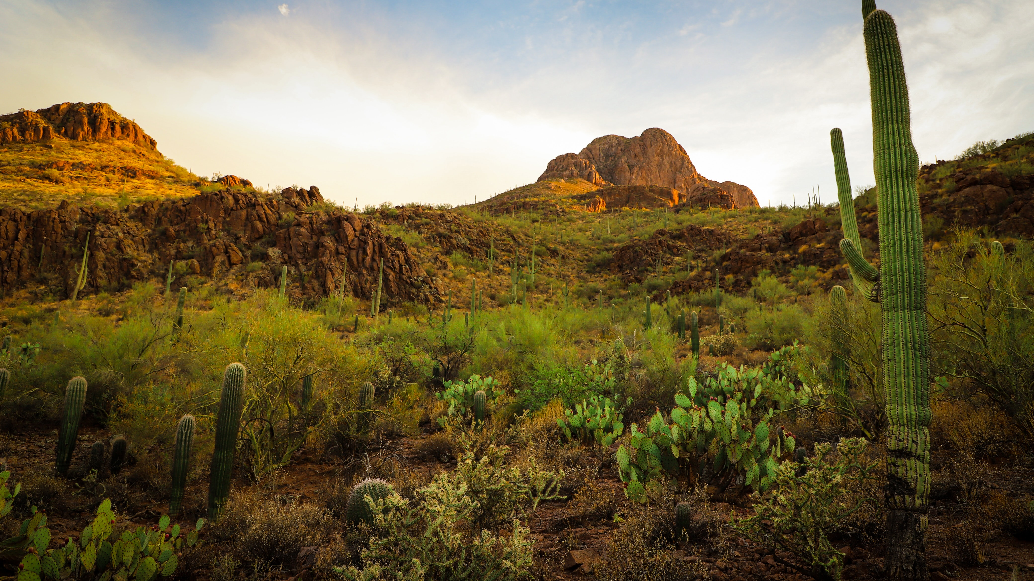
Tucson Geography, Ethnicity, and Education
By Melinda Fraser
11/11/2020

Slide 2
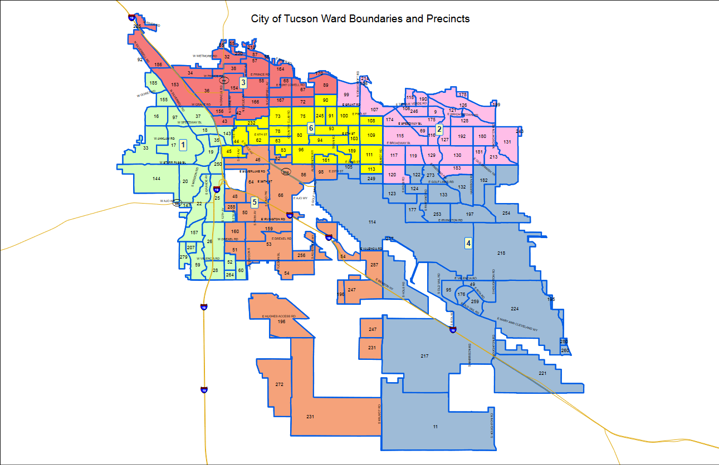
Tucson - Demographics
6 Wards
Diverse Population
Majority White and Hispanic
2 Native Tribes
Refugees
Notes:
The city of Tucson, AZ has a population of 546 thousand people. Of those over 40% identify as Hispanic. Tucson also is home to two native tribes – the Pascua yaqui and the Tohono O-Odham – and a diverse inclusion of Asian American, African American. As well as being home to refugees from all over.

Slide 3
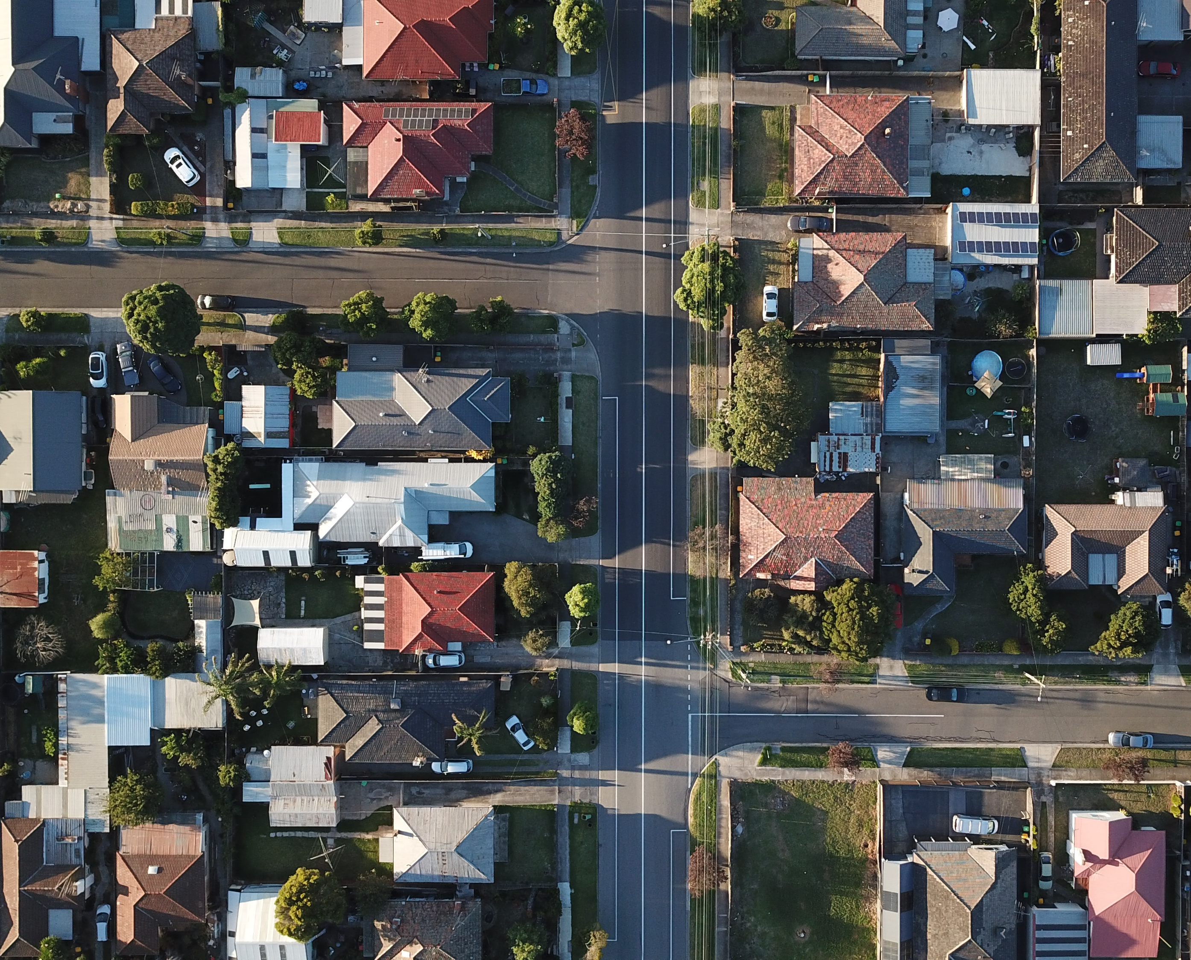
Hypotheses
White population will have higher education completion than others.
Wards with white majority population will have higher education completion than wards with Hispanic or other majority population.
Notes:
My focus was to see if there was any relationship between what ethnicity you are and your education completion, as well as if there was any relationship between what part of town you lived in (or ward you lived in) and if that effected your education completion rate. I want to clarify that when I say education completion or attainment, I am referring to if the person did not attend HS or dropped out, if the person graduated HS or received a GED, and if the person had any amount of post-secondary education – as in community college, associates, bachelors, or graduate degree.

Slide 4
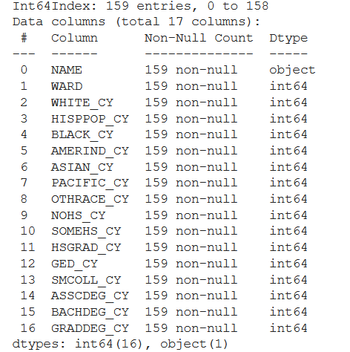
Data
City of Tucson
Demographics
Notes:
My data was taken from the City of Tucson’s open datasets available to the public. I was focused on the demographics of neighborhoods and wards in regards to ethnic background and education completion.

Slide 5
Method
Clean and Organize Data Sets
Correlations and Statistical Values
Descriptive Bar Charts
Notes:
My method was to compile, organize and clean the datasets I found from Tucson.gov. I then analyzed, did simple new calculations of percentages of reported numbers in comparison to total, for example, percentage of those who did not finish highschool out of all who were reported in the education survey. I compared them to each other with correlations and descriptive statistics. Finally I composed bar charts to help visualize the differences between the wards in respect to education and ethnicity.

Slide 6

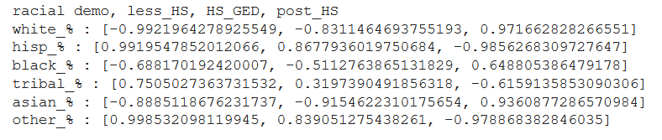
Ethnicity and Education Completion Correlations
Notes:
The initial correlations I looked at was between ethnic background and education completion.
At this point my hypotheses seemed to be on the right track. There is a strong relationship between being white or Asian American and completing HS and having post-secondary education. While there was a strong relationship between being Hispanic and Tribal and not completing HS or only having HS education.
The surprising find in this correlation was that there was a mild correlation between being black and having HS and post-secondary education, which could be an interesting subject for future research and analysis.

Slide 7
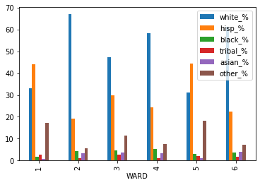
Ethnicity and Education Completion
The standard deviation for WHITE is 1.839 with a p-value of 0.067
The standard deviation for HISPANIC is 5.256 with a p-value of 4.76e-07
The standard deviation for BLACK is 2.829 with a p-value of 0.005
The standard deviation for AMERIND is 5.178 with a p-value of 6.81e-07
The standard deviation for ASIAN is -1.058 with a p-value of 0.291
The standard deviation for PACIFIC is 0.865 with a p-value of 0.387
The standard deviation for OTHER is 5.649 with a p-value of 7.43e-08
Notes:
I then had to verify these correlations and created a code to get the standard deviation and p-values for each ethnic background and education completion. I was surprised to see that my null hypothesis for white ethnicity was borderline at failing to reject the null, as I considered it my basis. I later attributed this to the spread of ethnicities across the neighborhoods and wards in Tucson – as those white americans living in wards with majority Hispanic, would have similar opportunities and obstacles for completing education. Asian and Pacific Islander, also failed to reject the null, and are also considered more of an expected baseline for education attainment.

Slide 8
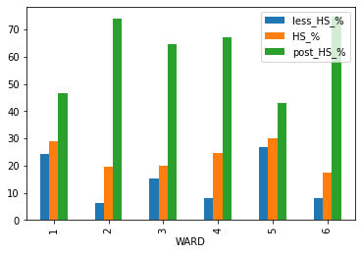
Ward and Education
The standard deviation for less_HS is -5.568 with a p-value of 1.09e-07
The standard deviation for HS_GED is -2.869 with a p-value of 0.004
The standard deviation for post_HS is 1.504 with a p-value of 0.134
Notes:
When I did the statistics for significance of education per ward, not completing HS and completing HS both strongly rejected the null. While, surprisingly, post-secondary education failed to reject the null. I attribute this to the “some college” category of those who may have taken a class or two at community college but never completed a program. This would be open to anyone even those who did not finish HS. I take this as needing to revise the post-secondary criteria for further exploration and not using it for my current analysis.

Slide 9
Insights
The higher % of white population, the higher completion of HS and Post-Secondary attainment
Notes:
Overall my hypotheses were substantiated. With the side by side bar charts, it is clear to see that wards 1 and 5 with a majority Hispanic population have the highest rates of no HS or HS drop outs. Surprisingly, we see that the HS completion or GED certification is relatively the same throughout the wards. I attribute wards 2 and 6 having a lower HS and GED number, to having higher post-secondary education attainment and that skewing the numbers.

Slide 10
Recommendations
Wards 1 and 5 need attention
Associated with Hispanic and Tribal populations
Aid and Outreach for attending and finishing HS and beyond
Encourage white population to move there?
Notes:
After this analysis, I would encourage the school districts and education boards to look at increasing funding and outreach programs to wards 1 and 5. Encouraging and aiding these traditionally Hispanic and minority rich areas of our city to finish High School and pursue further education.
When I look at these wards on the map, it relates to my personal knowledge of what parts of town are considered richer and poorer, and where I would expect to find better education. The West and South sides of Tucson are frequently associated with Hispanic and Tribal populations and being less developed or rougher. Whereas the East and North sides of town are usually more white, have more retirees (indicating a higher number of post-secondary education to have been able to retire), and have better school districts.
Another area of interest, would be to see if there is a way to attract more affluent populations to the West and South wards to help increase the money cycling through these areas and increase resource sharing.

Slide 11

Sources
https://www.tucsonaz.gov
https://gisdata.tucsonaz.gov/
US Census

